Slide 1
问题求解智能体

Slide 2
大纲
问题求解智能体
问题形式化
无信息的搜索
有信息的搜索
超越傳統搜索

Slide 3
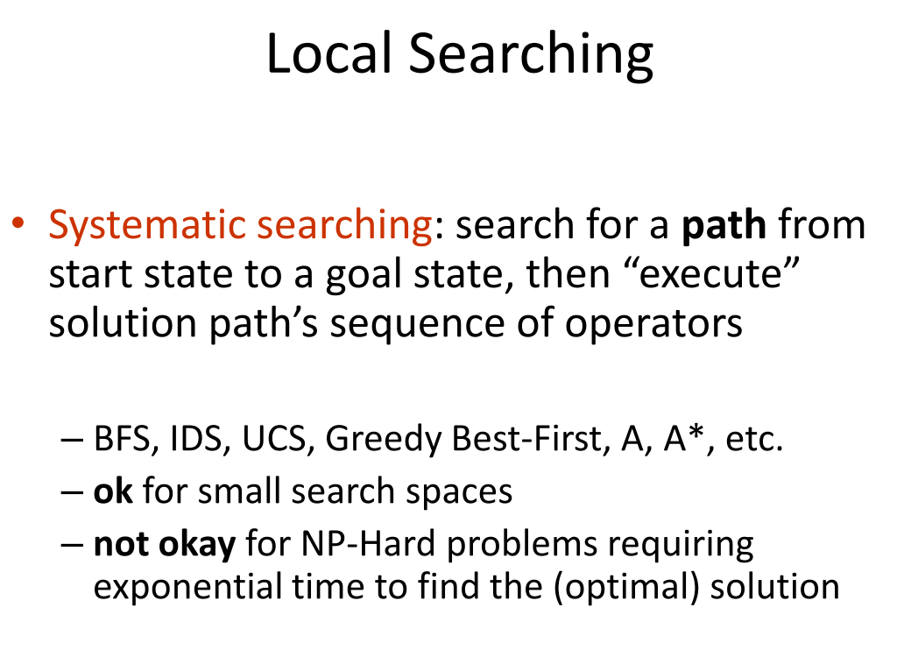

Slide 4
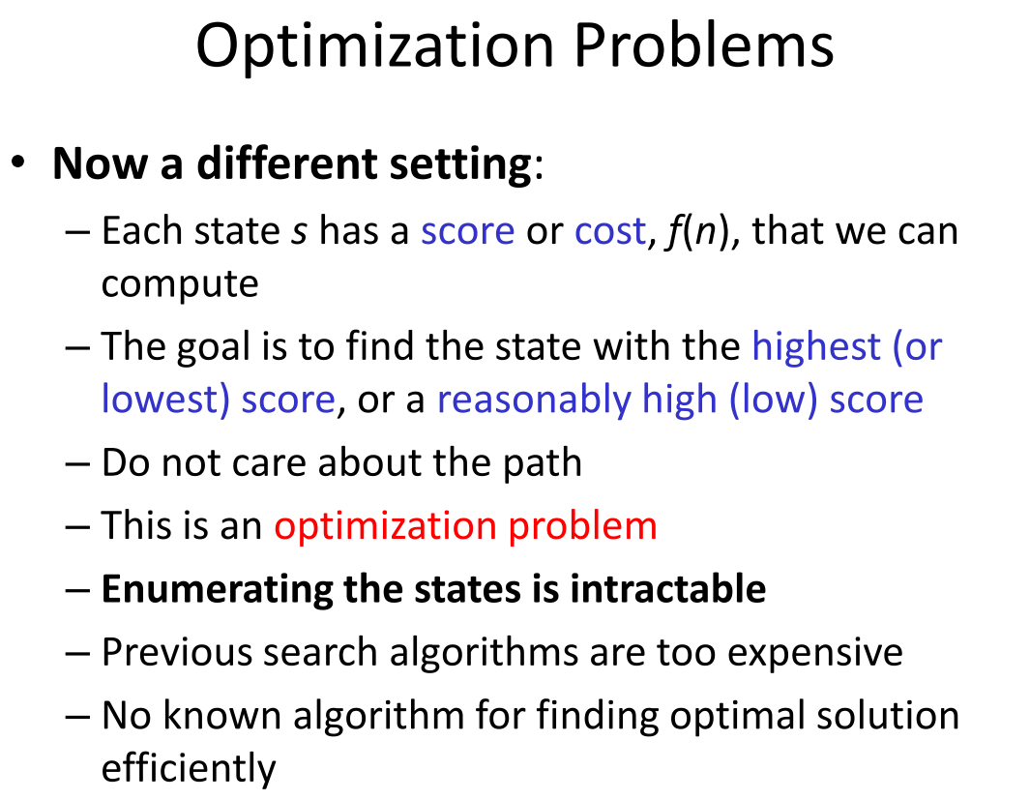

Slide 5
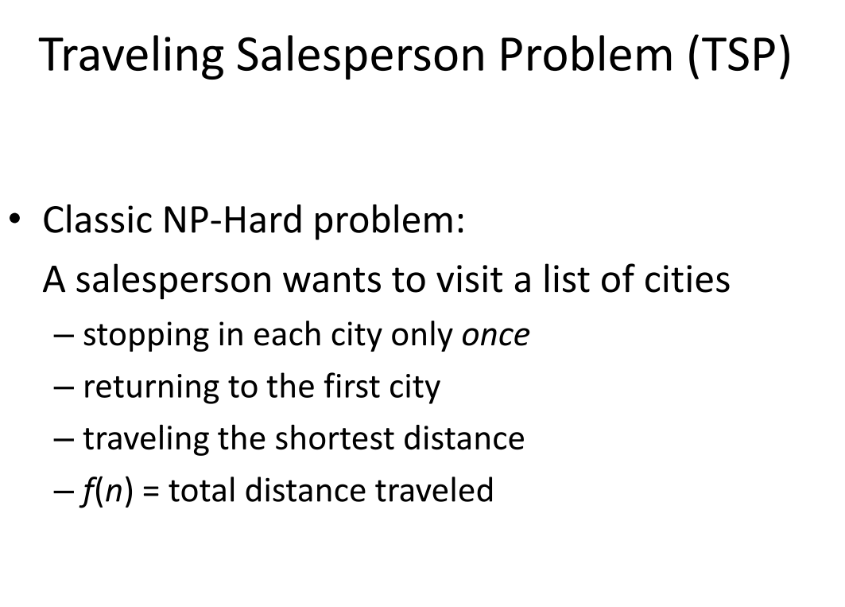

Slide 6
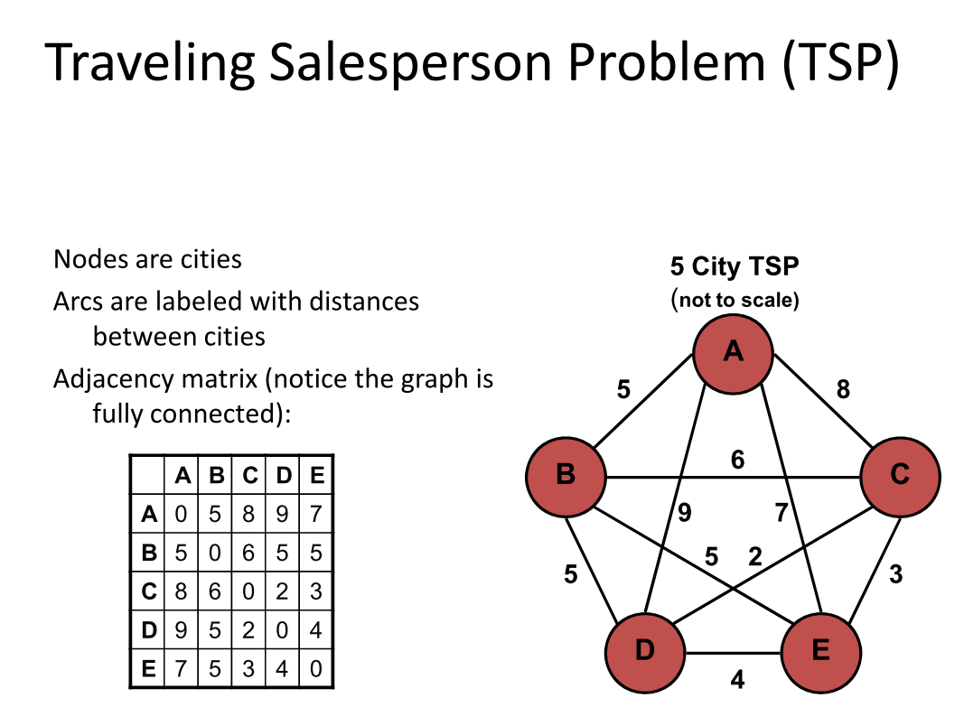

Slide 7
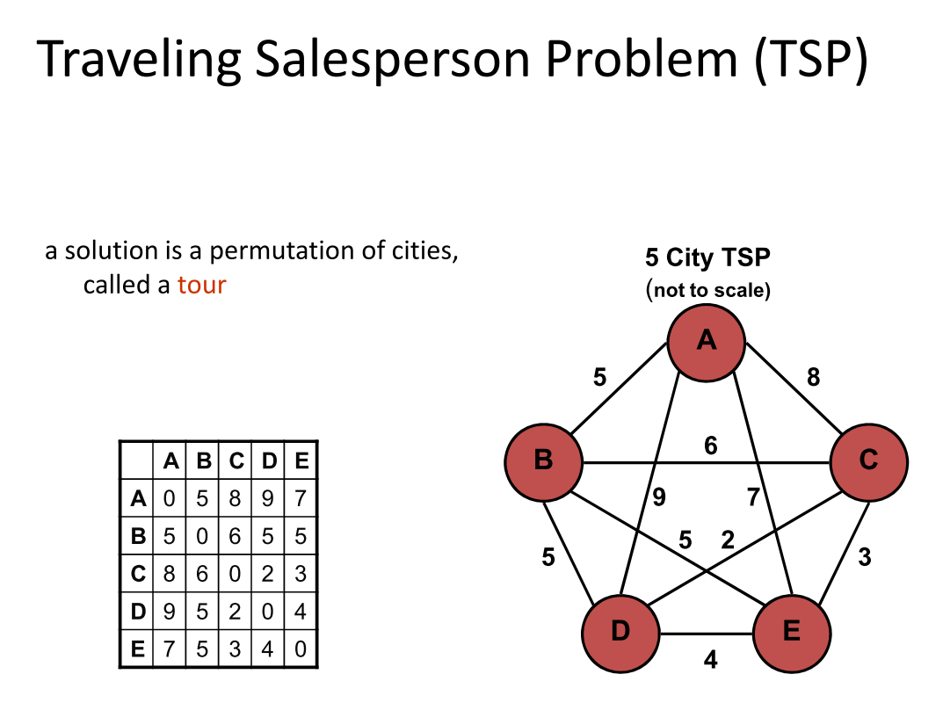

Slide 8
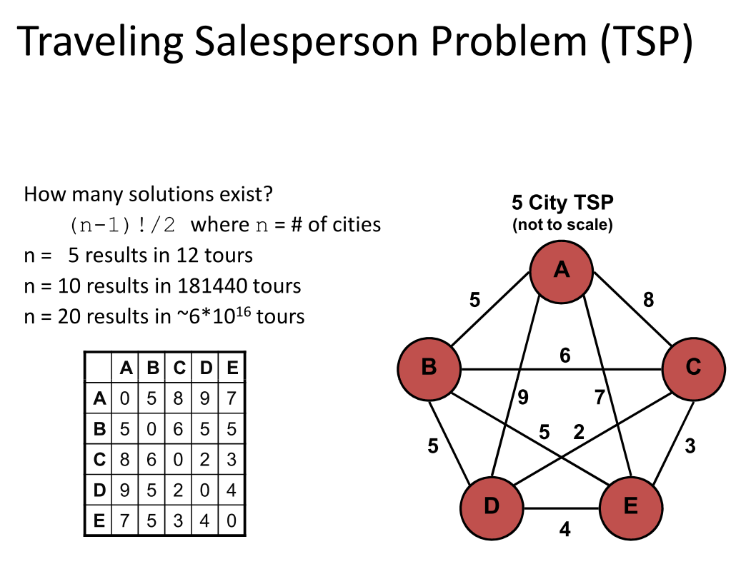

Slide 9
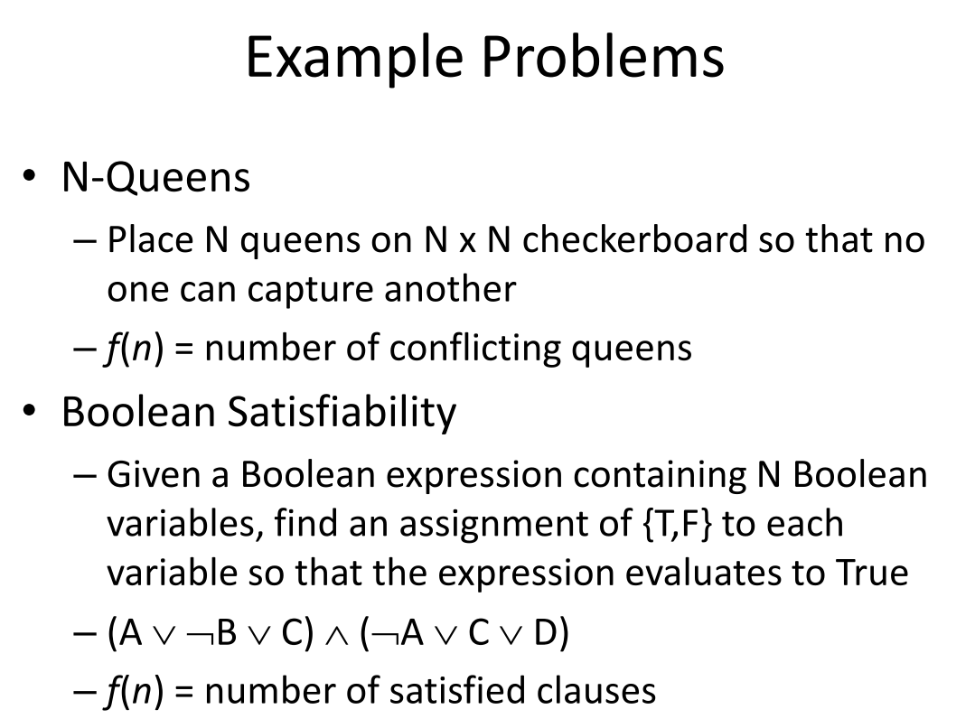

Slide 10
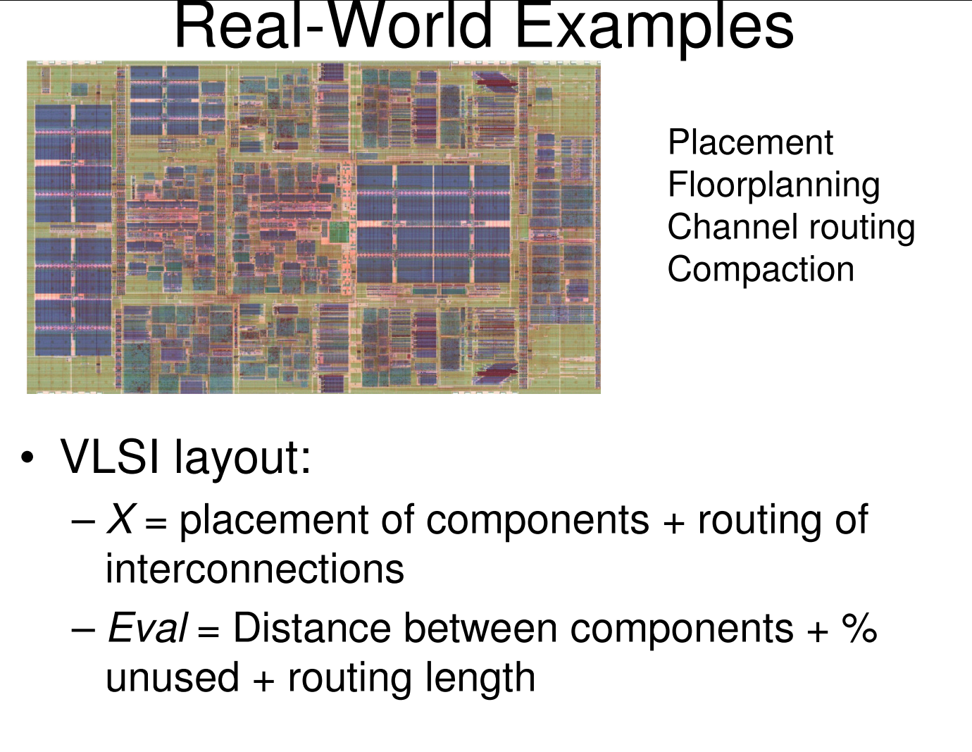

Slide 11
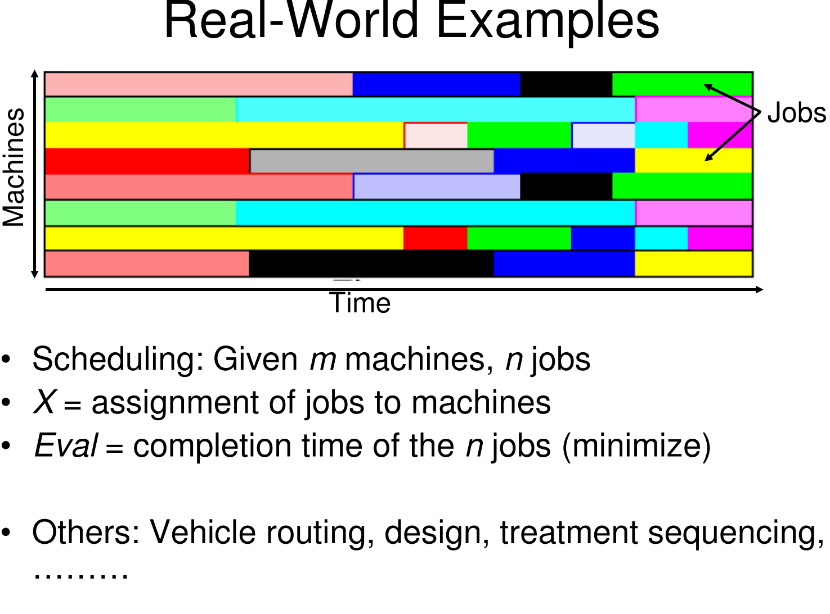

Slide 12
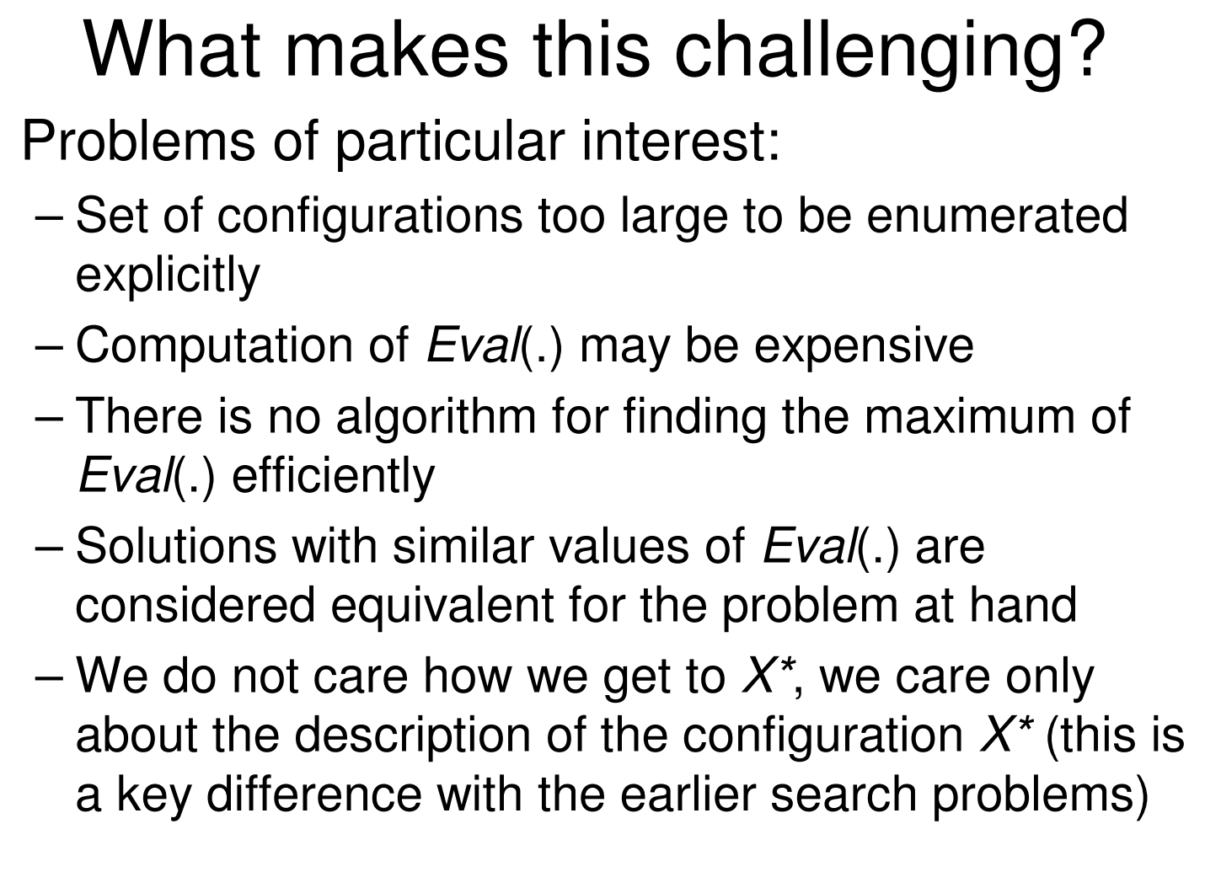

Slide 13
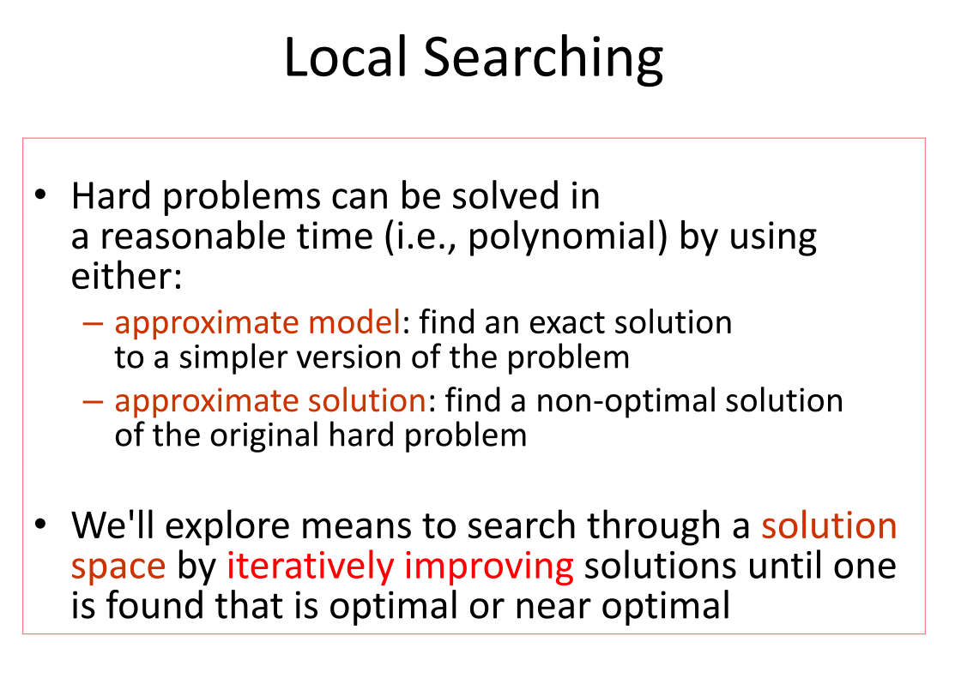

Slide 14
Local search algorithms
State space = set of "complete" configurations
Find configuration satisfying constraints, e.g., n-queens
Constant space, suitable for online as well as offline search
A* isn't a local search since it searches different partial solutions by looking at estimated cost of a solution path

Slide 15
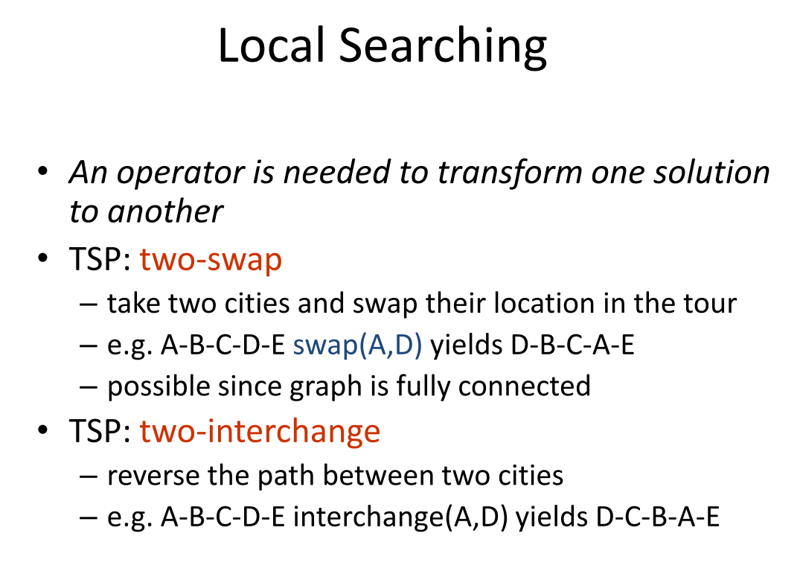

Slide 16
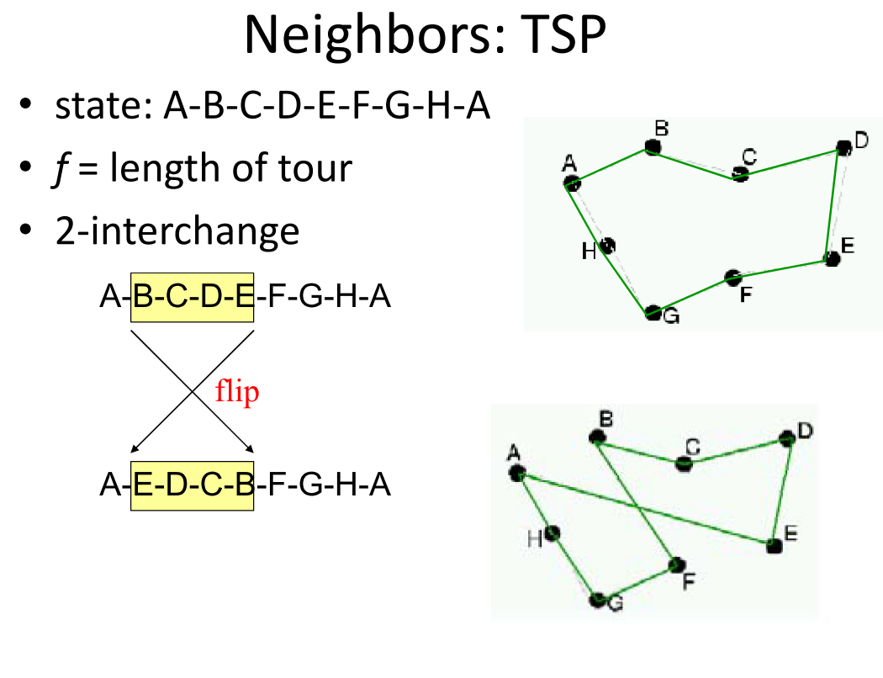

Slide 17
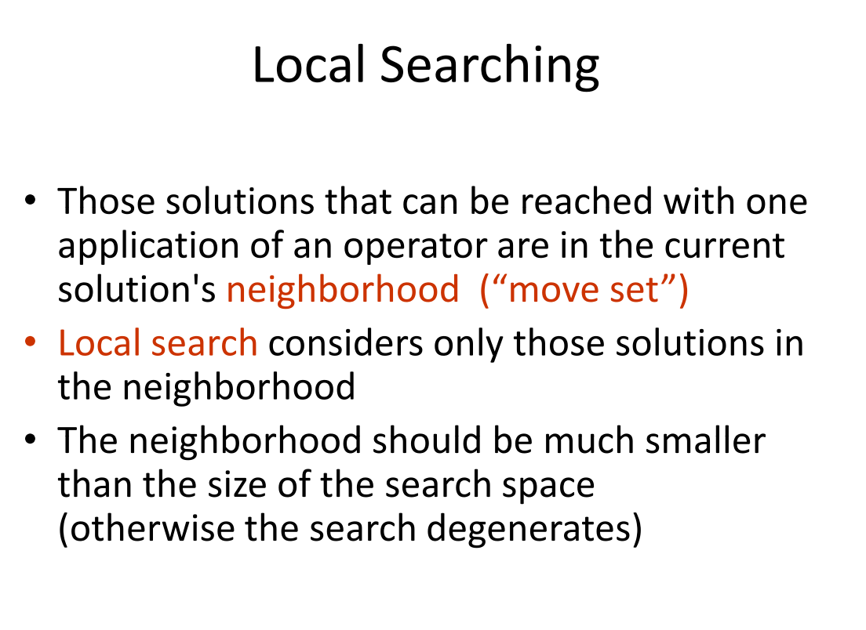

Slide 18
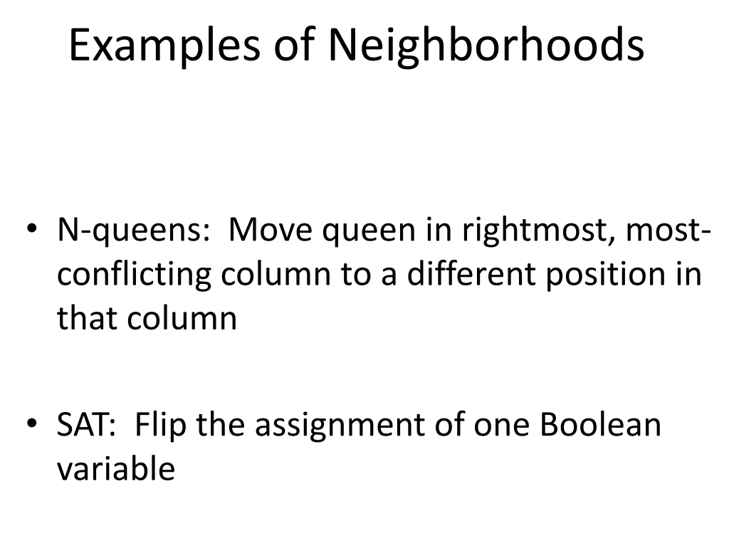

Slide 19
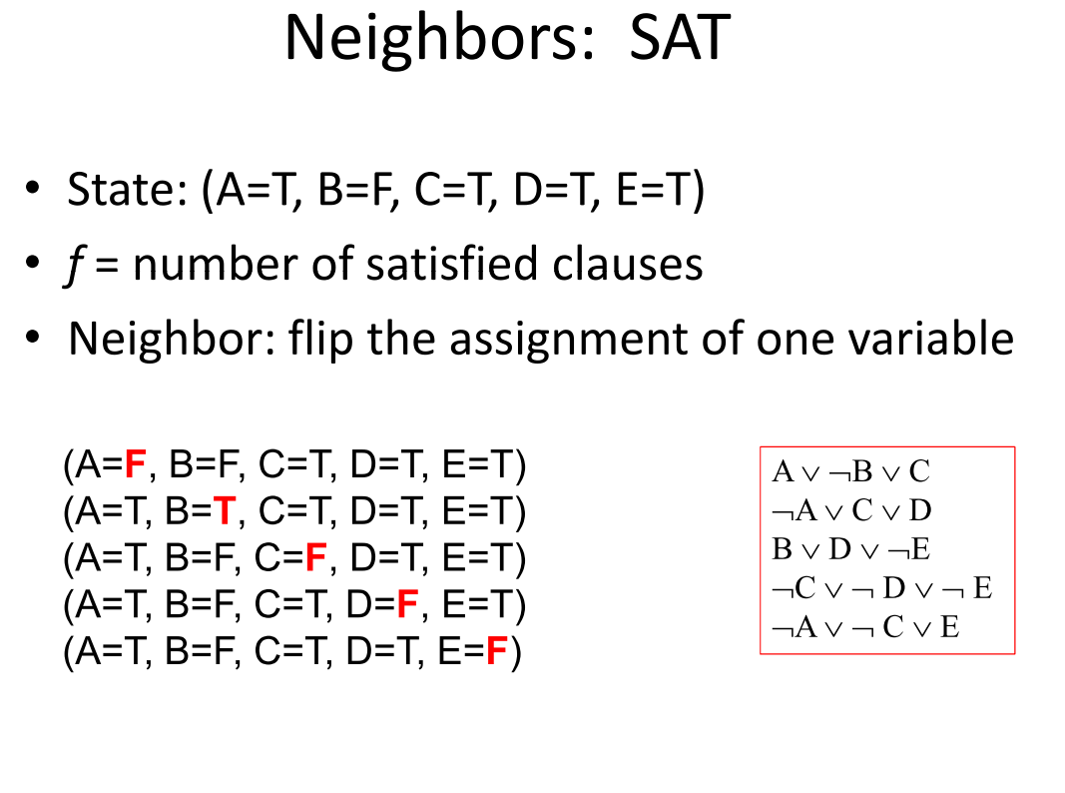

Slide 20
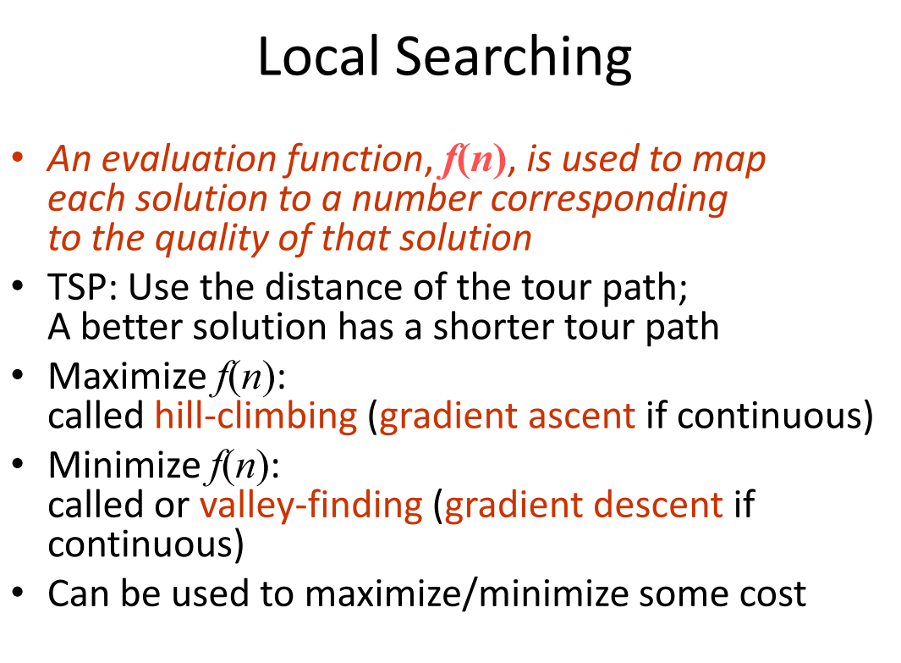

Slide 21
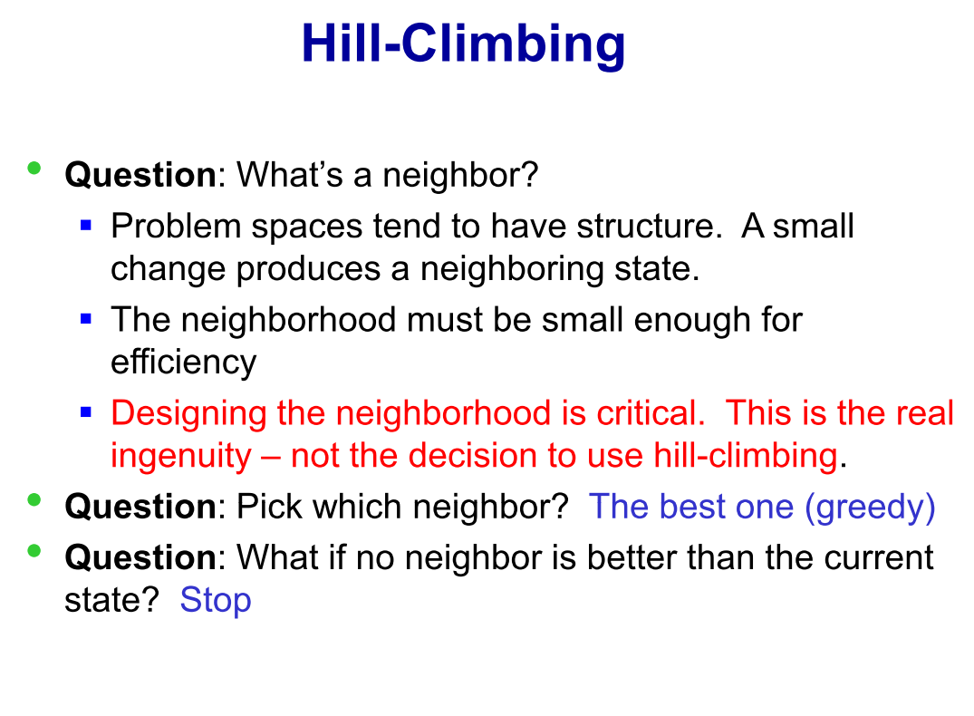

Slide 22
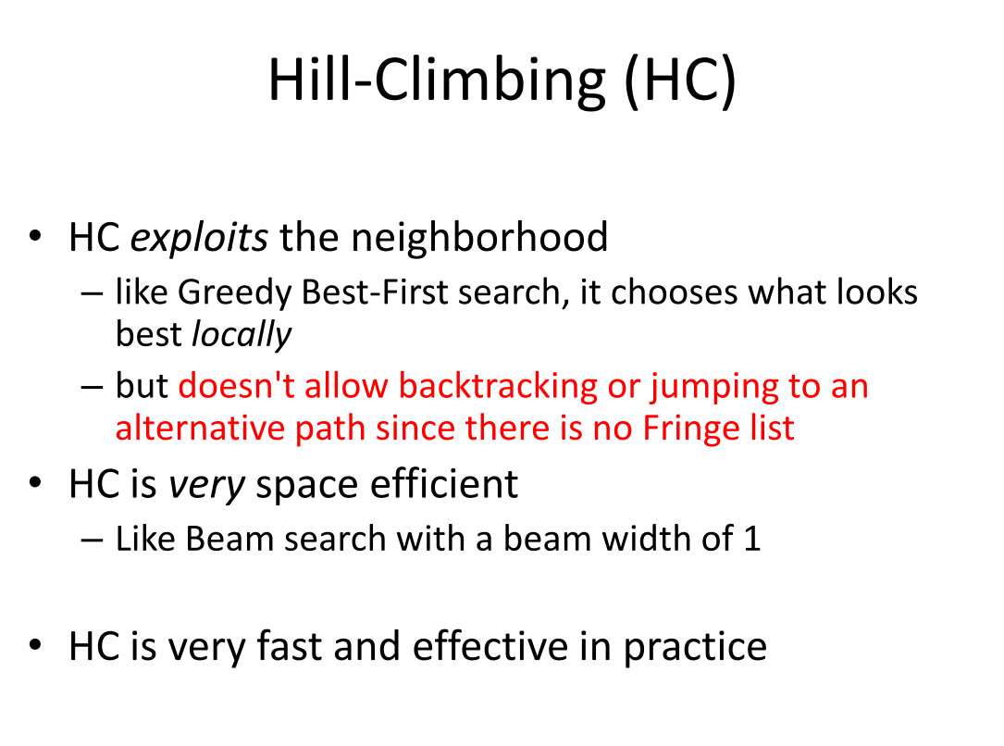

Slide 23
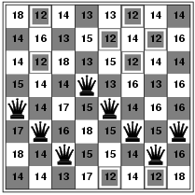
Hill-climbing search: 8-queens problem
h = number of pairs of queens that are attacking each other, either directly or indirectly
h = 17 for the above state

Slide 24
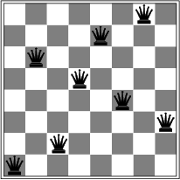
Hill-climbing search: 8-queens problem
A local minimum with h = 1

Slide 25
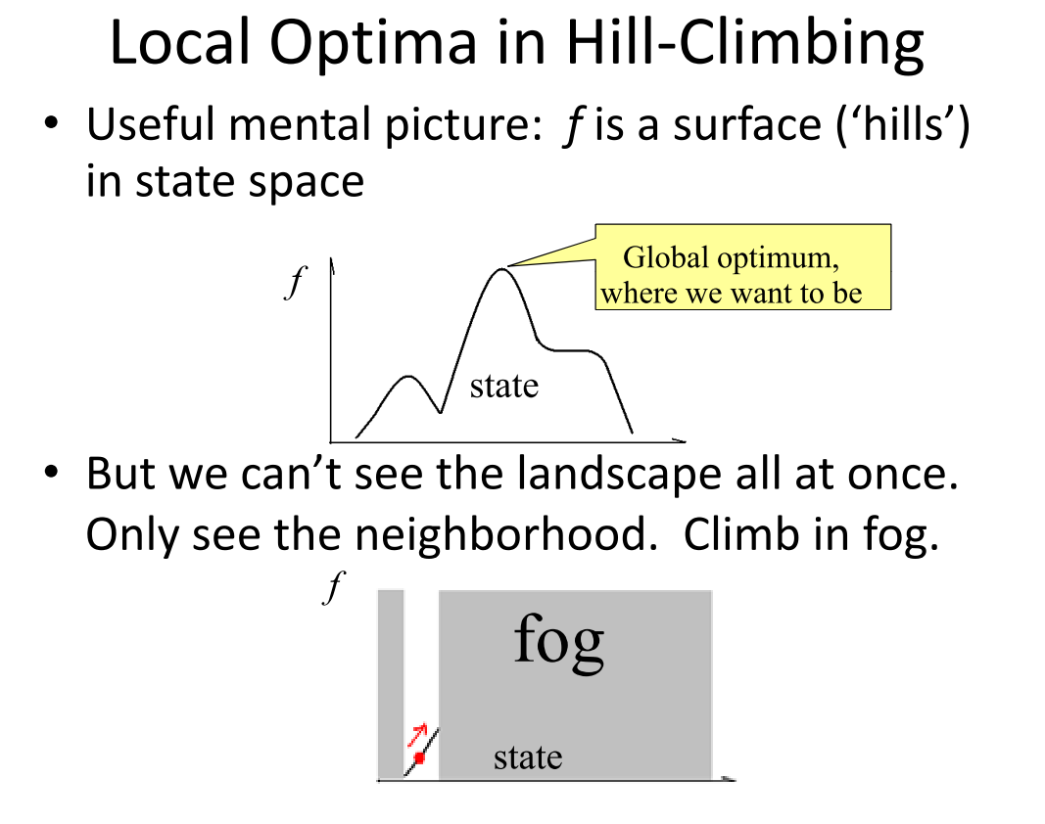

Slide 26
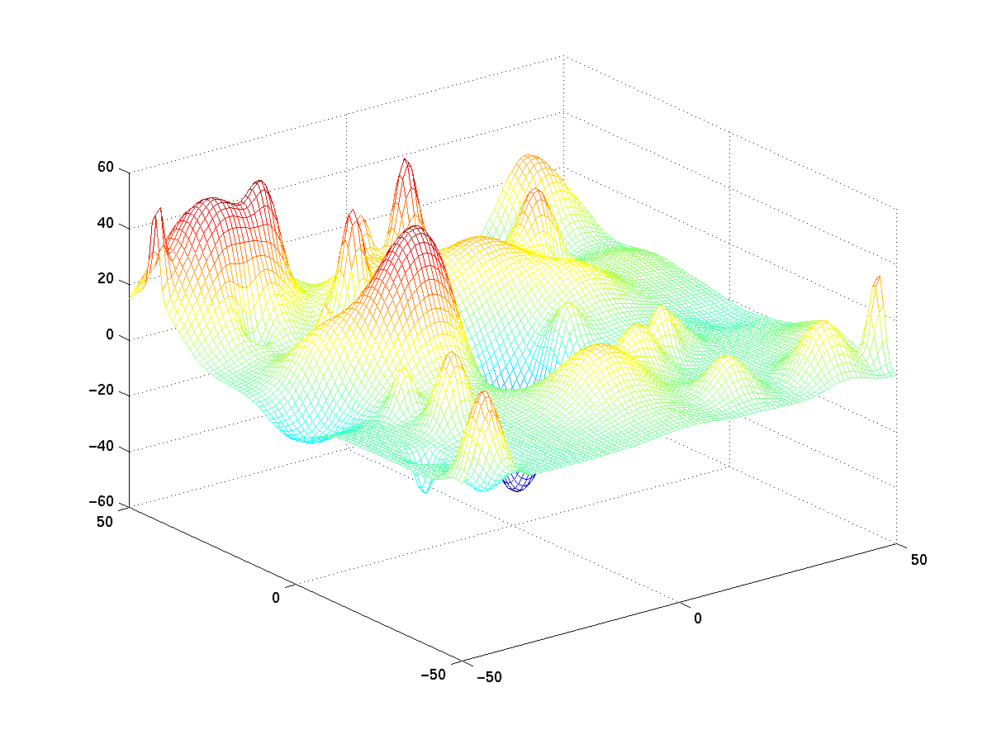

Slide 27
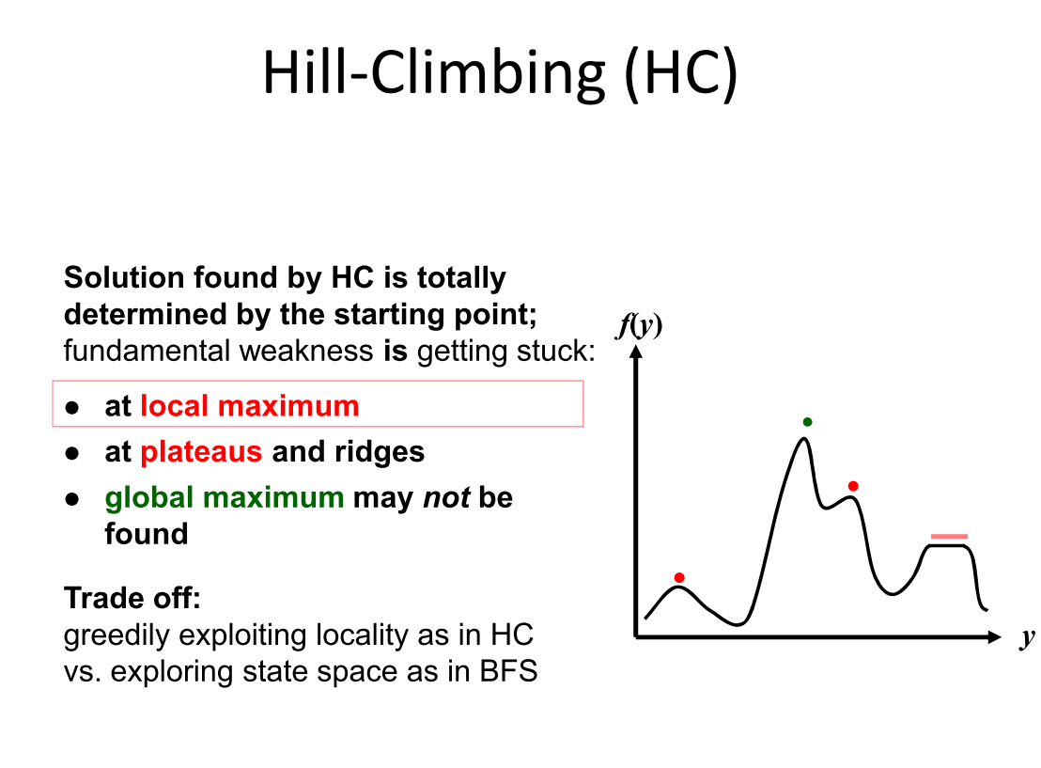

Slide 28
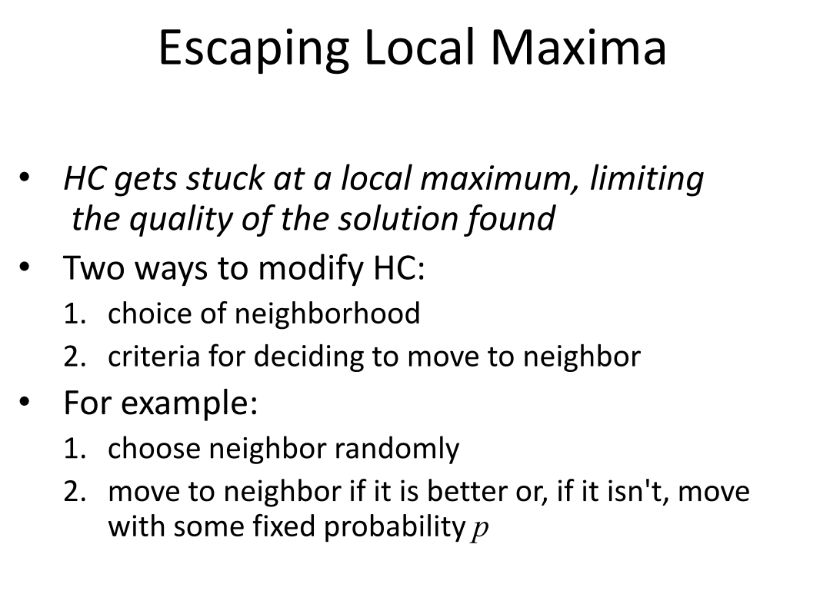

Slide 29
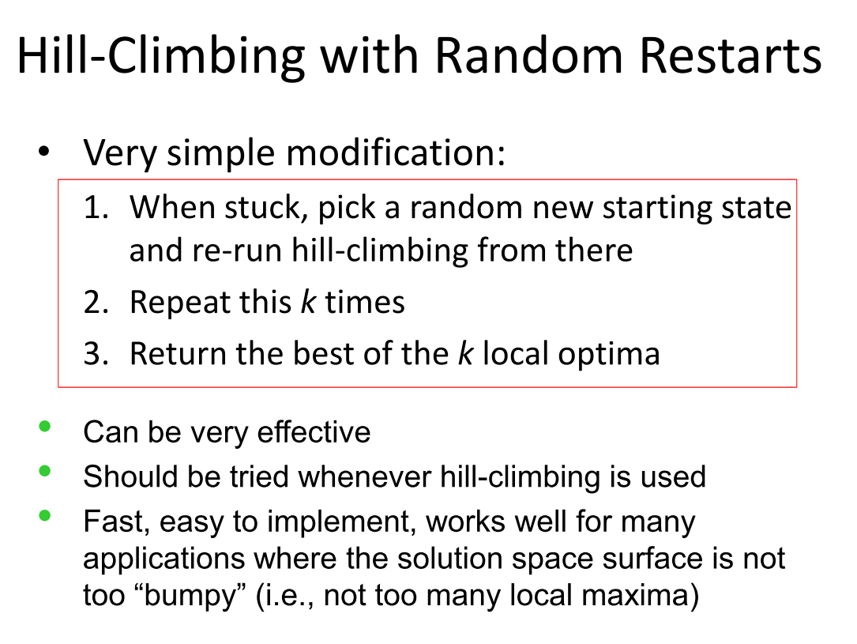

Slide 30
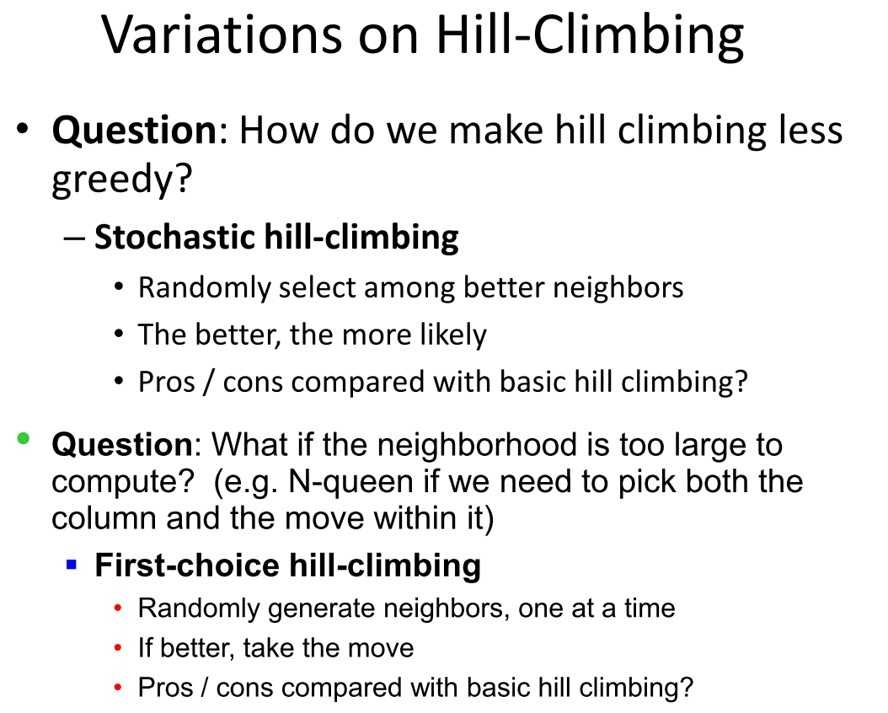

Slide 31
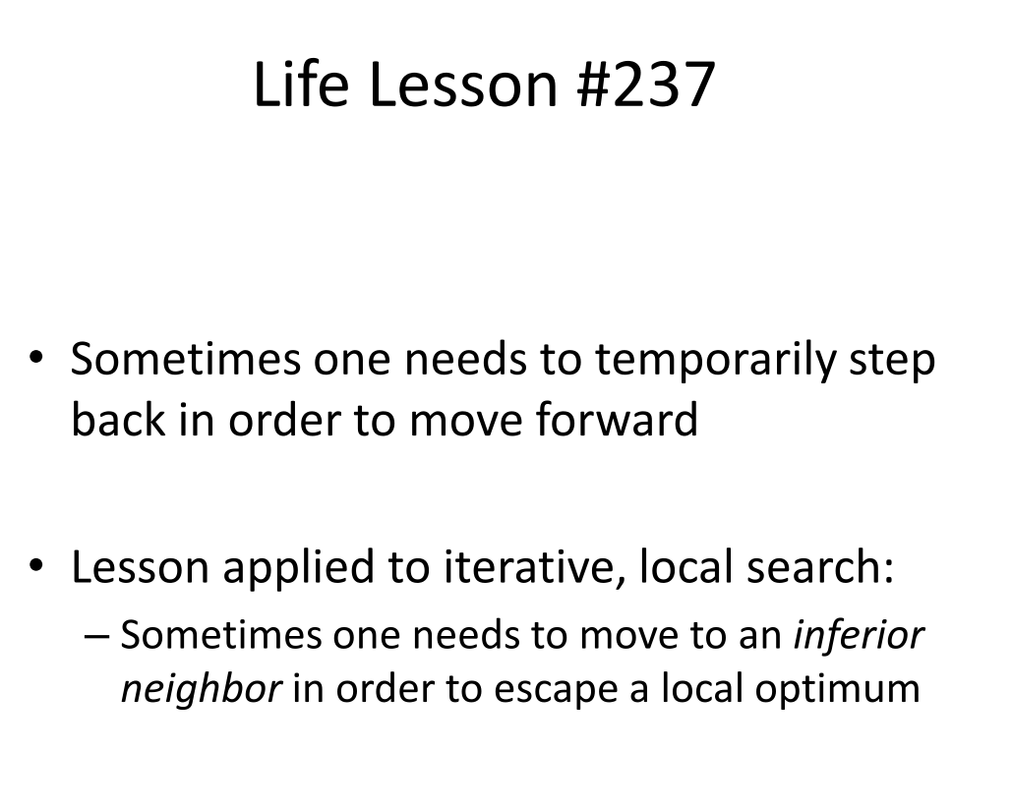

Slide 32
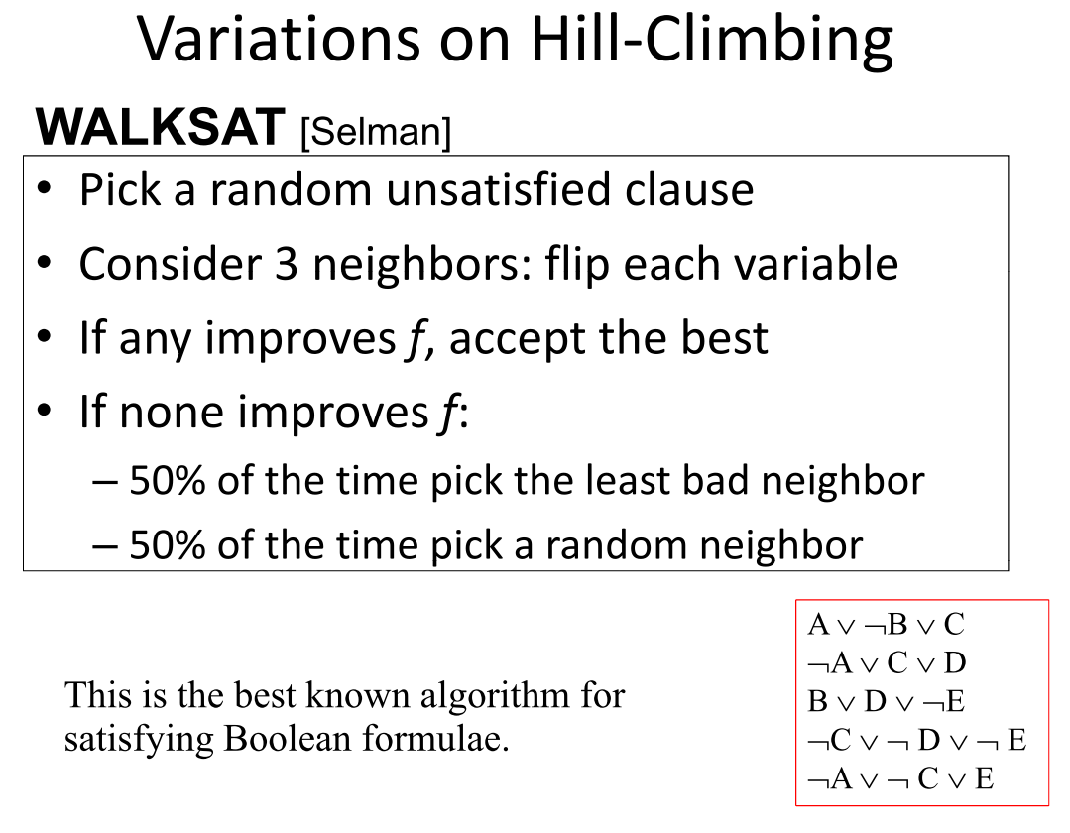

Slide 33
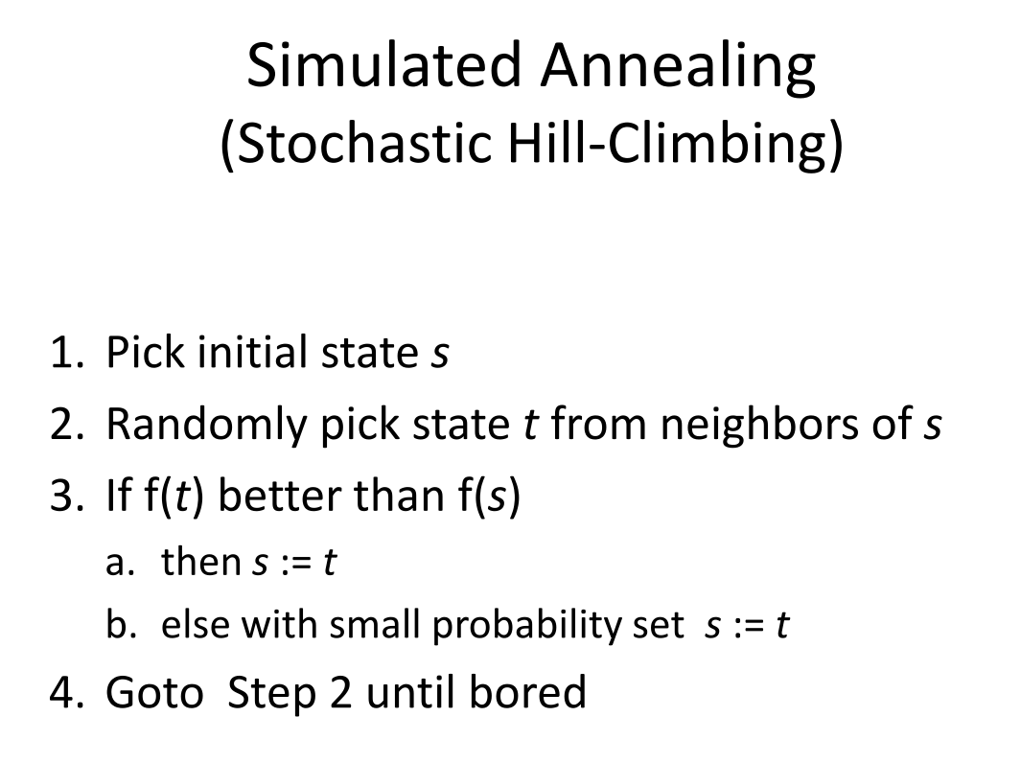

Slide 34
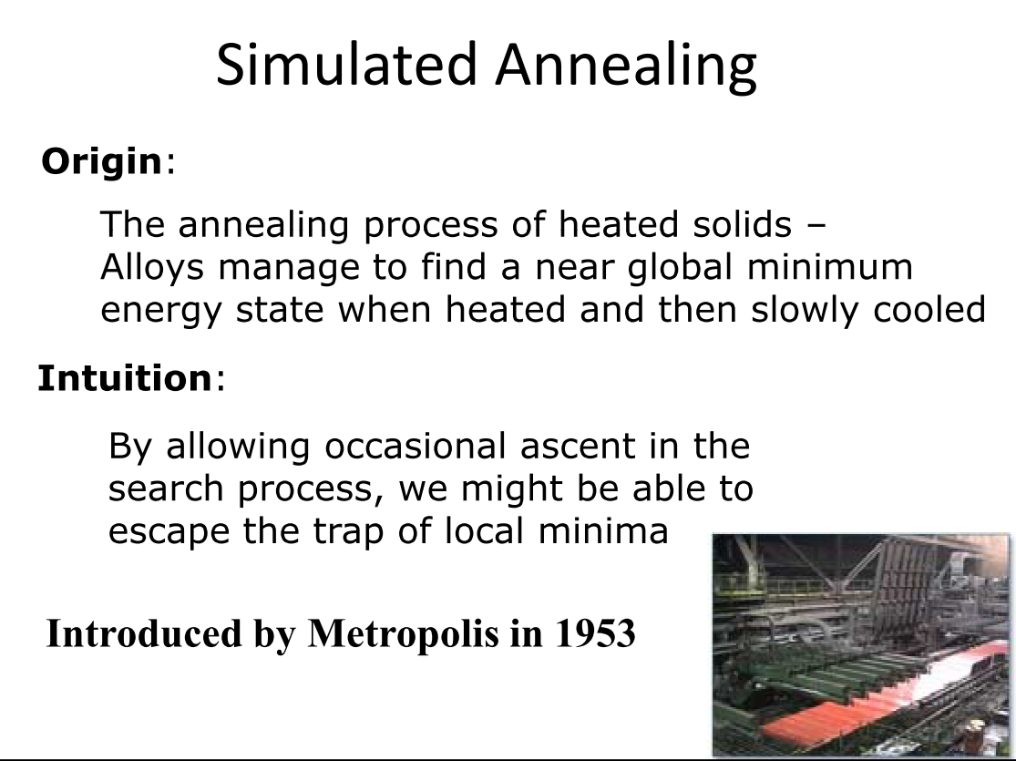

Slide 35
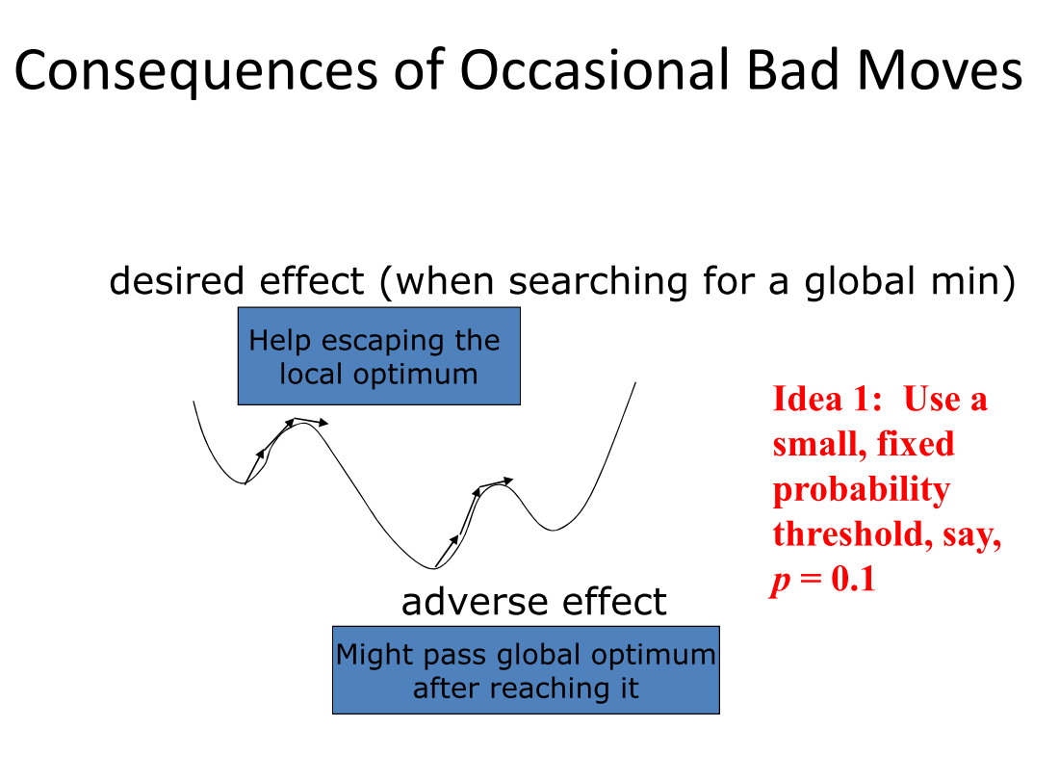

Slide 36
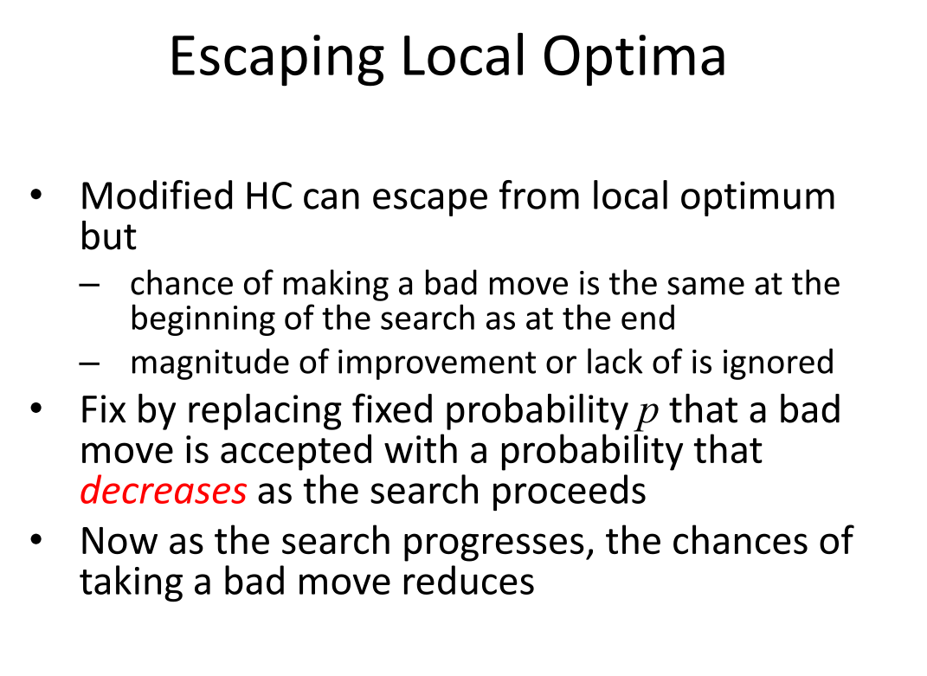

Slide 37
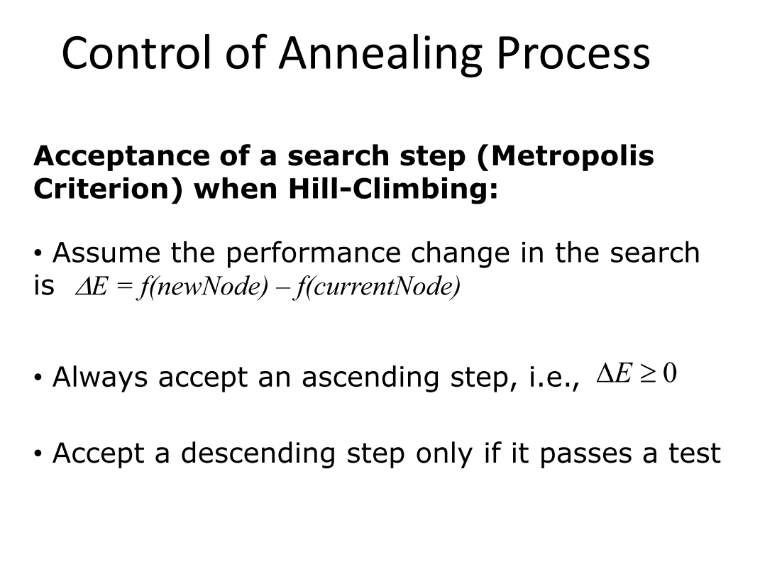

Slide 38

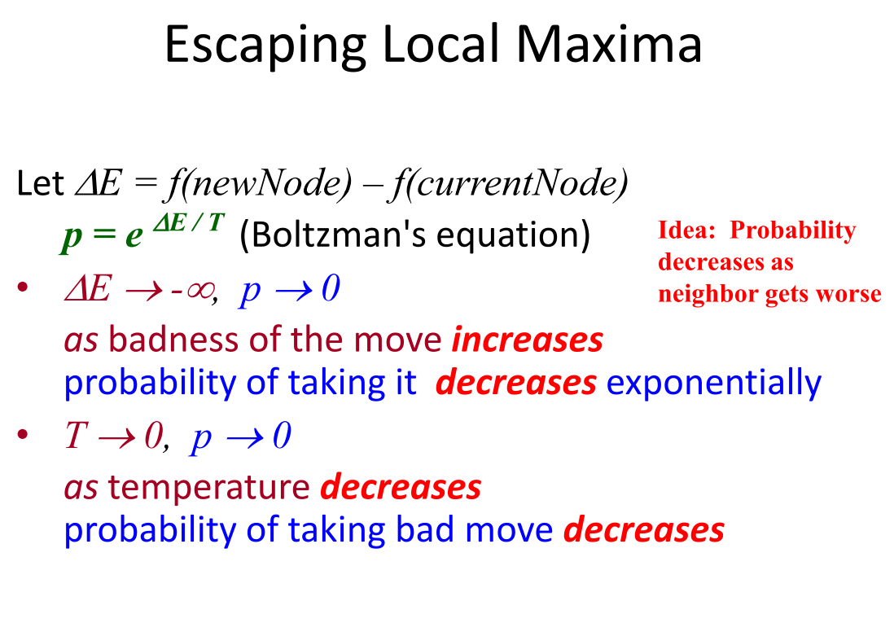

Slide 39
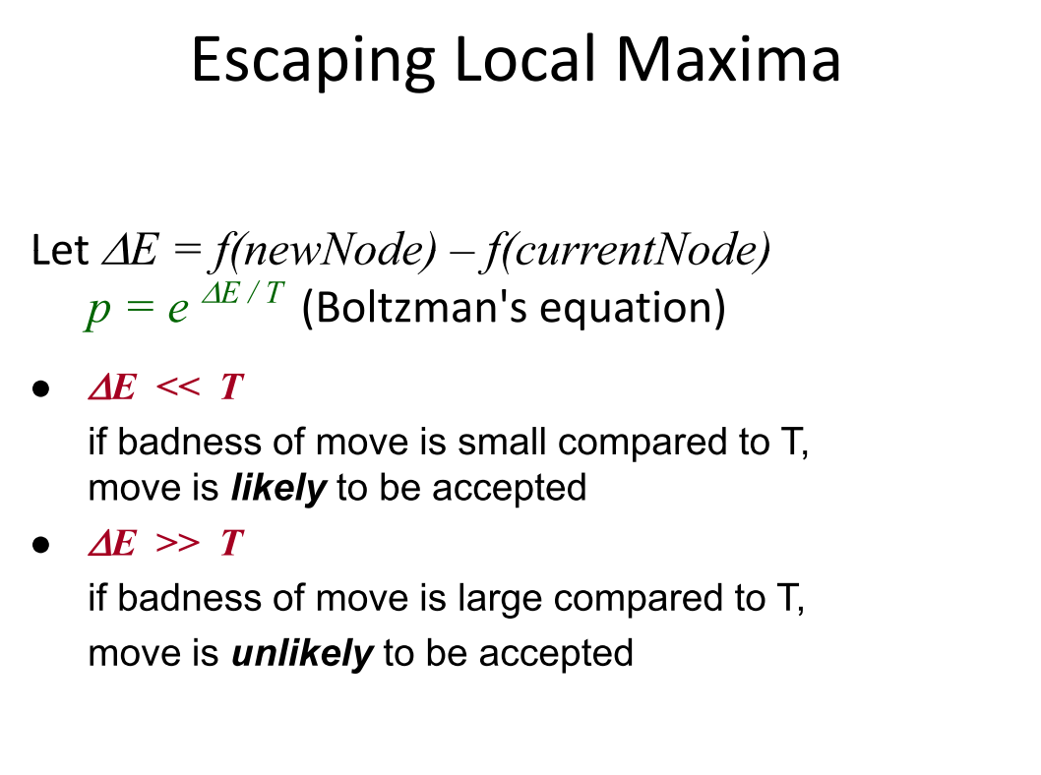

Slide 40
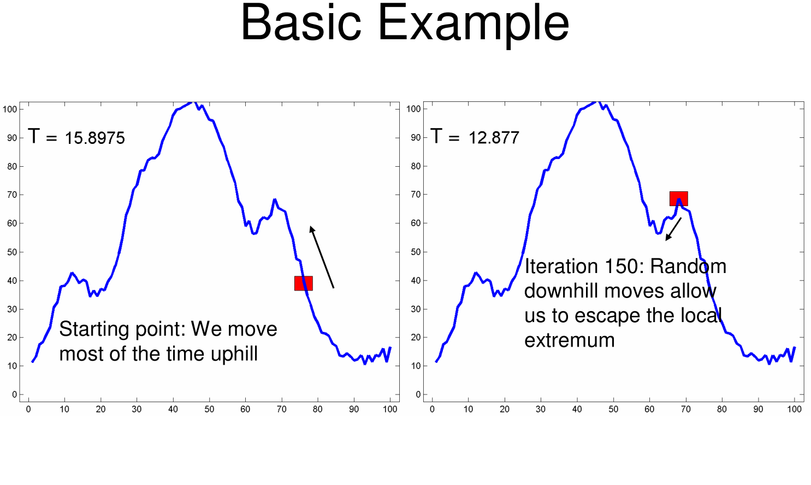

Slide 41
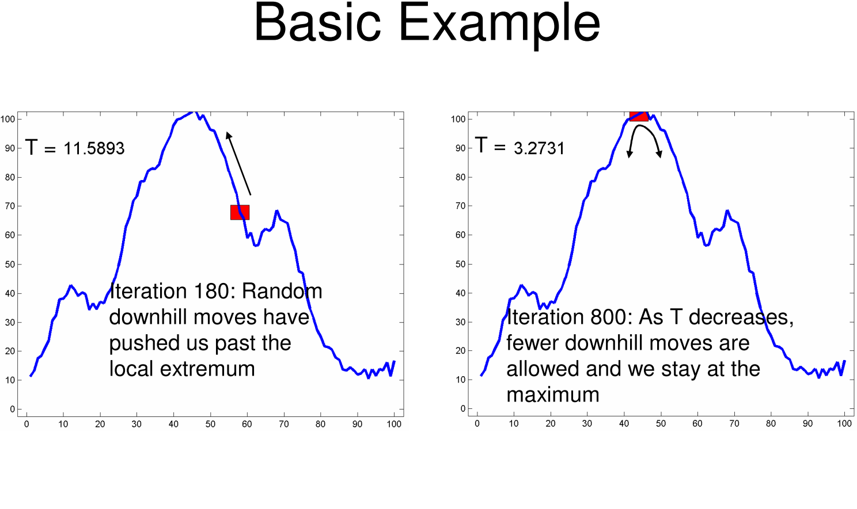

Slide 42
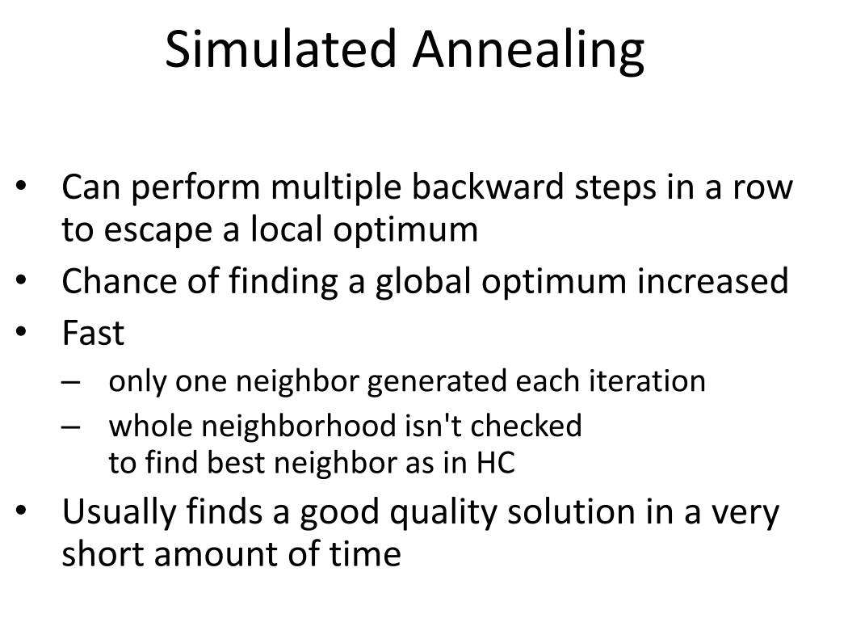

Slide 43
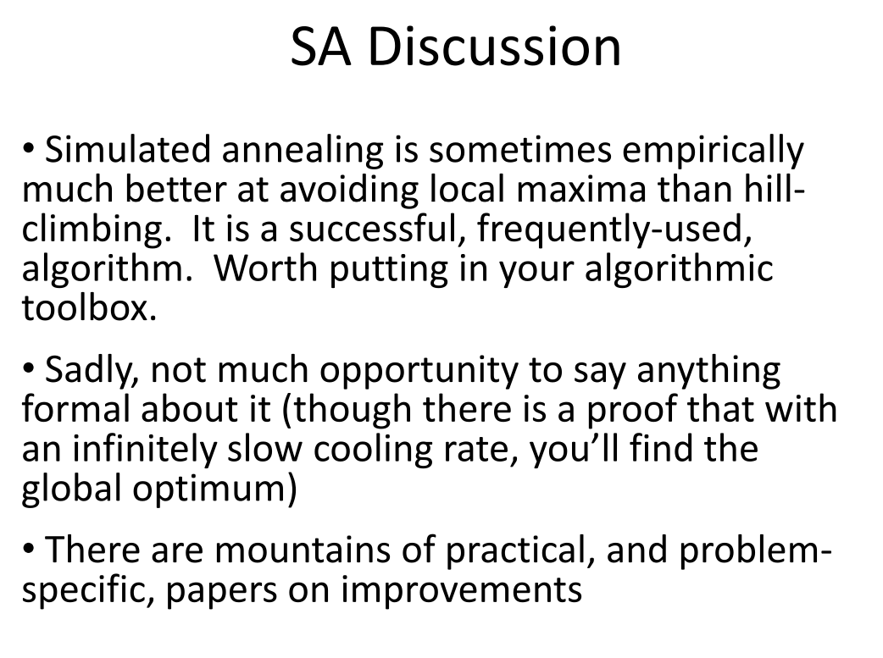

Slide 44
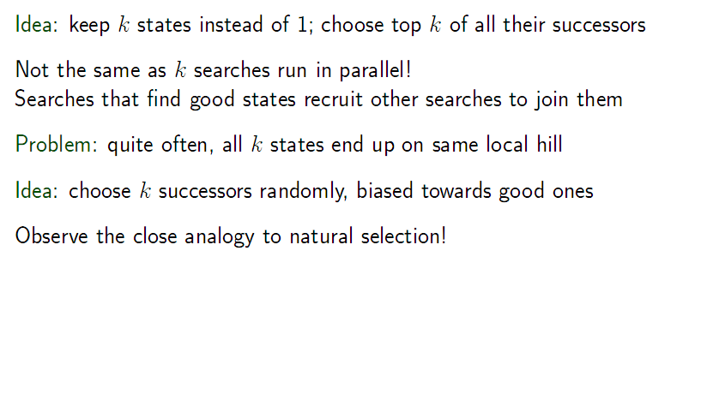
Local beam search
課本(第二版)此處翻譯有誤！

Slide 45
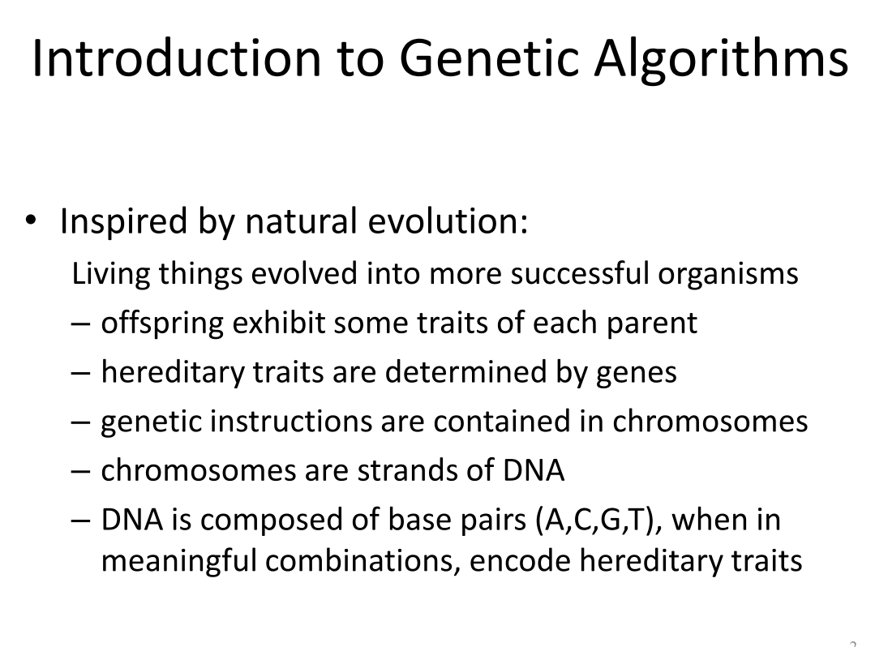

Slide 46
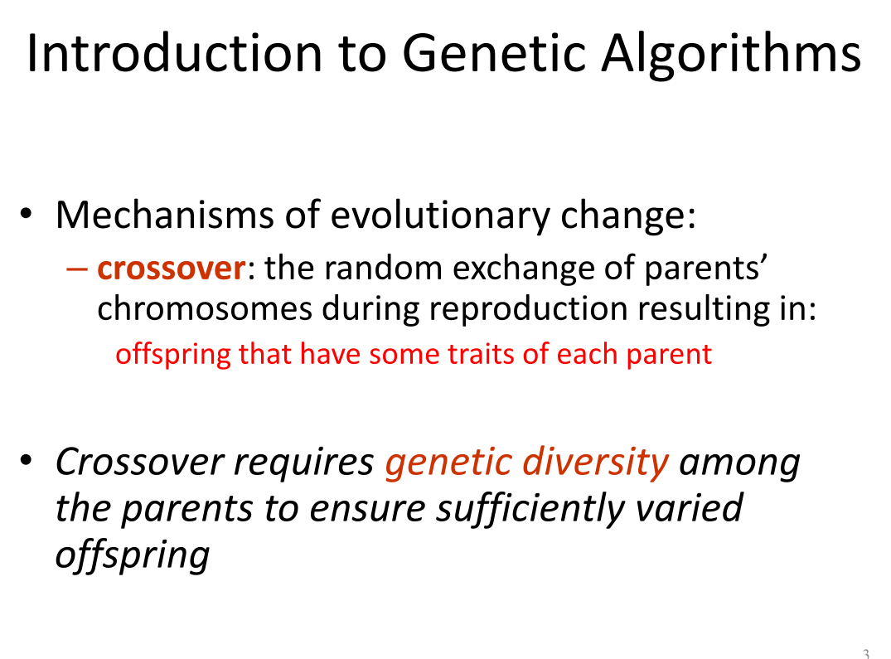

Slide 47
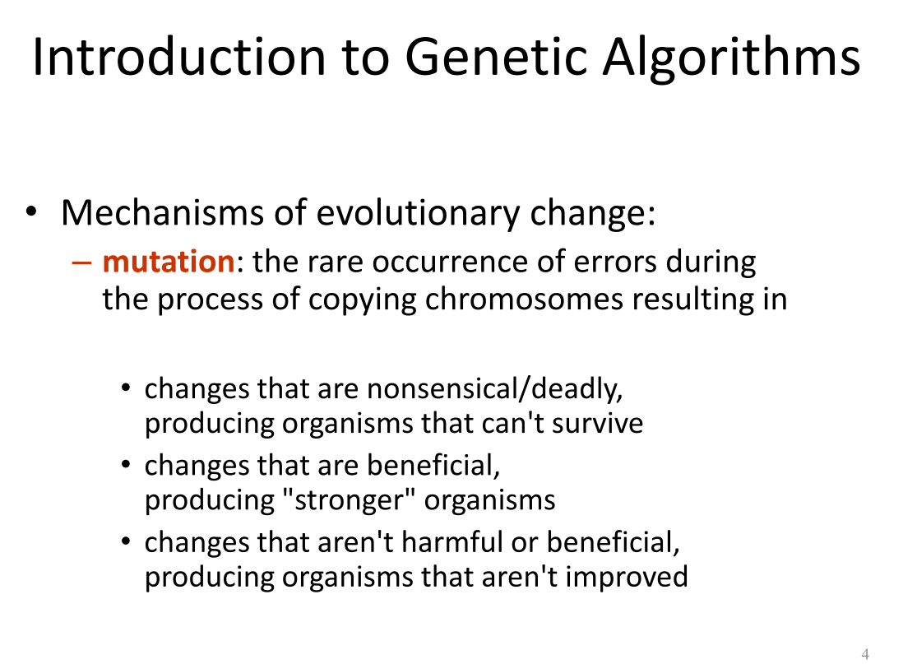

Slide 48
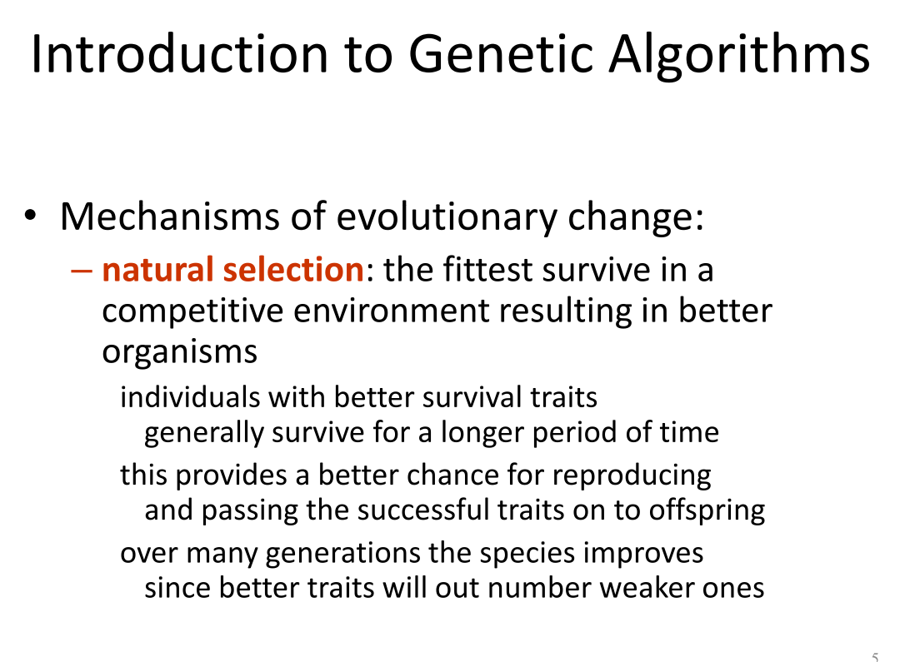

Slide 49
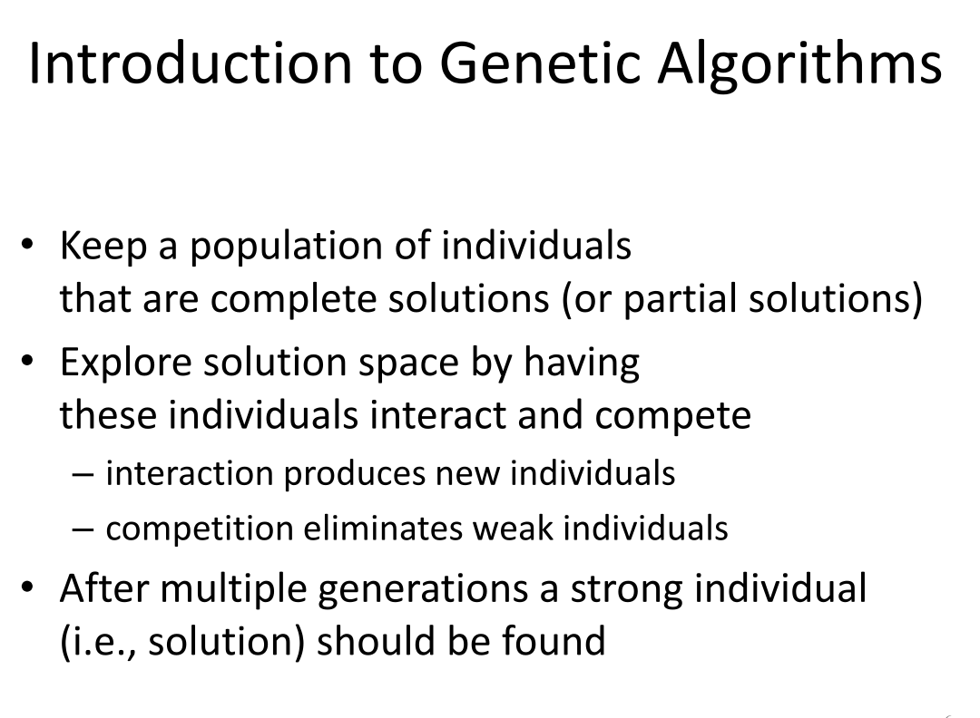

Slide 50
Genetic algorithms
A successor state is generated by combining two parent states
Start with k randomly generated states (population)
A state is represented as a string over a finite alphabet (often a string of 0s and 1s)
Evaluation function (fitness function). Higher values for better states.
Produce the next generation of states by selection, crossover, and mutation

Slide 51
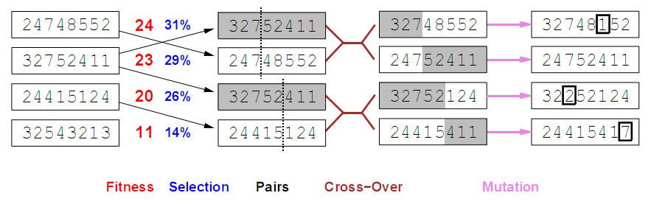
Genetic algorithms
Fitness function: number of non-attacking pairs of queens (min = 0, max = 8 × 7/2 = 28)
24/(24+23+20+11) = 31%
23/(24+23+20+11) = 29% etc

Slide 52
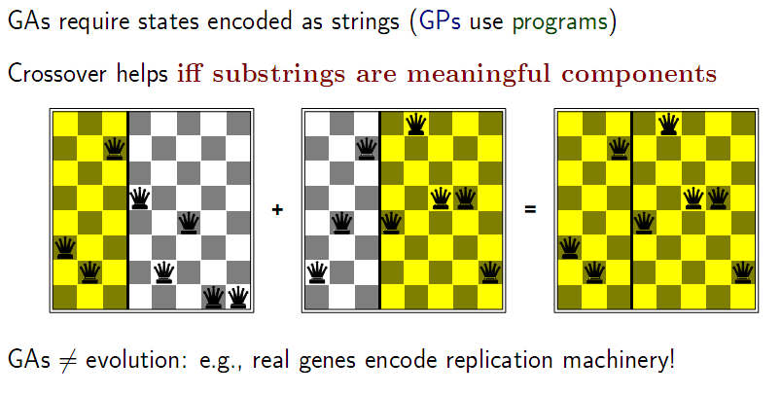
Genetic algorithms

Slide 53
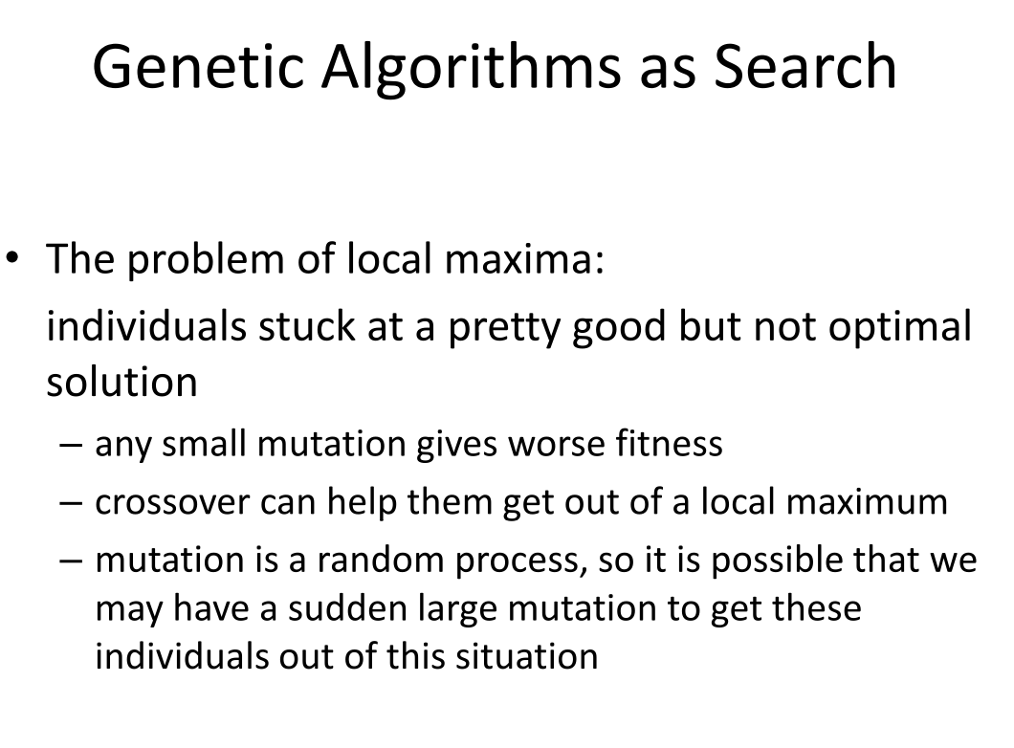

Slide 54
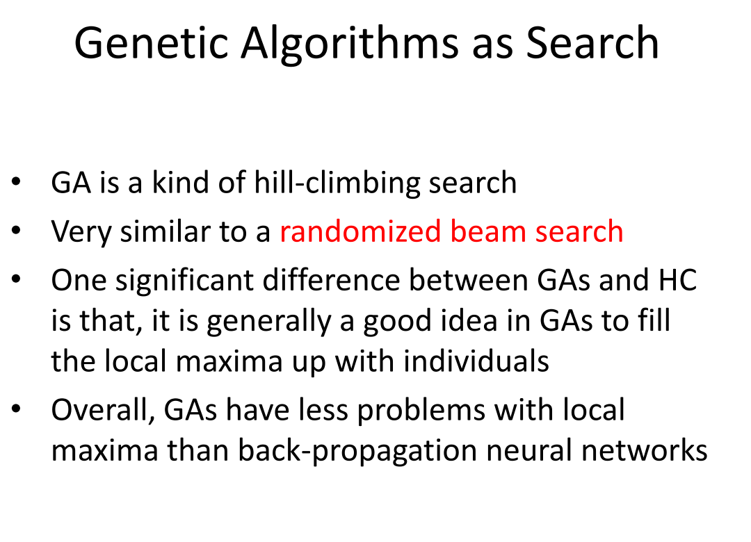

Slide 55


Slide 56


